Slide 1
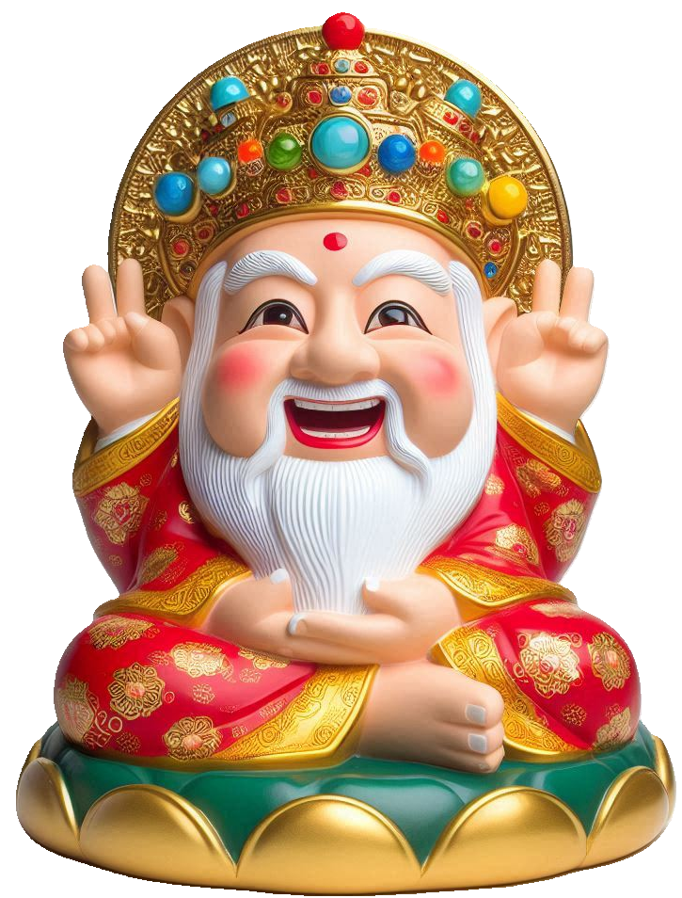








1
CMDSP
2
$$+$$
50%
3
15%
OFF
4
5
Cost
Marked Price
Discount
Selling Price
Profit
C
$ 100
M
$ 150
D
$ 127.5
S
$ 128
P
$$=$$
S
$$−$$
C
$$=$$
$ 28
(1
$$+$$
50%)
(1
$$−$$
15%)
Round Off
S
$$−$$
C
P
%
$$=$$
%
1.5
0.85
C
一成本二標價，三折四售，五倍利潤笑哈哈
28
P
%
$$=$$
%
$$=$$
28
%
100
Growth Rate
$$+$$
50%
Decay Rate
$$−$$
15%
Growth Factor
(1
$$+$$
50%)
Decay Factor
(1
$$−$$
15%)

Slide 2
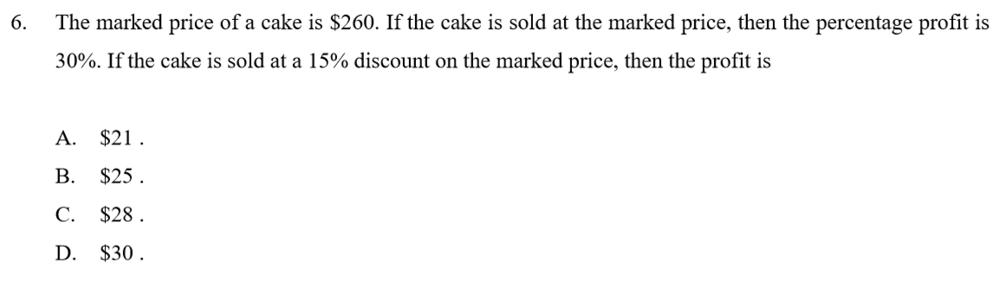
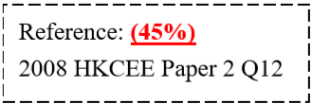












1
CMDSP
2
$$+$$
30%
3
15%
OFF
4
5
Cost
Marked Price
Discount
Selling Price
Profit
C
M
$ 260
D
S
P
$$=$$
S
$$−$$
C
C
(1
$$+$$
$$=$$
(1
$$−$$
15%)
S
$$=$$
260
(1
$$−$$
15%)
30%)
260
一成本二標價，三折四售，五倍利潤笑哈哈
Growth Rate
$$+$$
50%
Decay Rate
$$−$$
15%
Growth Factor
(1
$$+$$
50%)
Decay Factor
(1
$$−$$
15%)
2
2
4
3
5
1
C
Let be the cost of the cake.
3
2
C
(1
$$+$$
$$=$$
30%)
260
4
S
$$=$$
260
(1
$$−$$
15%)
C
$$=$$
200
S
$$=$$
221
5
P
$$=$$
S
$$−$$
C
P
$$=$$
221
$$−$$
200
$$=$$
$ 21

Slide 3











Percentage Constant Rate
Old value
Change factor
New Value
Example
1000
$+$10%
x
$$=$$
1000
$$×$$
(1
$$+$$
10%)
New Value
$$=$$
1100
Old value
n
Change factor
New Value
Example
10000
$+$10%
x
Value change yearly
Starting time$:$ Beginning of 2021
$$=$$
5
n
Ending time$:$ The end of 2025
$$×$$
(1
$$+$$
5
$$=$$
10%)
New Value
10000
$$=$$
14641

Slide 4

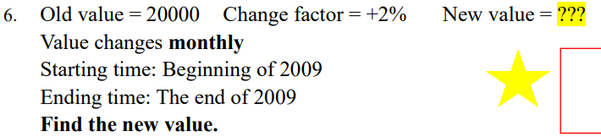

















New Value
$$=$$
8000
$$×$$
(1
$$−$$
15%)
$$=$$
6800
$$×$$
$$=$$
$$×$$
$$+$$
1
12
New Value
20000
(1
2%)
$$=$$
25365

Slide 5






Old value
n
Change factor
New Value
Example
x
$+$10%
9680
Value change yearly
Starting time$:$ Beginning of 2021
$$=$$
n
2
Ending time$:$ The end of 2022
2
x
(1
$$+$$
$$=$$
9680
10%)
2
x
$$=$$
9680
(
1.1)
x
$$=$$
8000
The Old value is 8000.

Slide 6
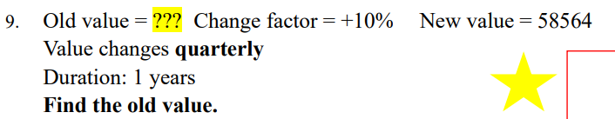










Let the old value be x
1
$$×$$
4
x
(1
$$+$$
10%)
$$=$$
58564
x
4
(
$$=$$
1.1)
58564
x
$$=$$
40000
The Old value is 40000.

Slide 7




























Old value
$$=$$
12000
Value of television
Change factor
4
$$=$$
$−$20%
$$=$$
$$×$$
(1
$$−$$
20%)
12000
n
$$=$$
4
$$=$$
$4915.2
New value
$$=$$
x
Old value
Let Alex’s monthly salary 4 years ago be x
$$=$$
x
Change factor
4
$$=$$
$+$8%
x
(1
$$+$$
8%)
$$=$$
22000
4
n
$$=$$
4
x
$$=$$
(
1.08)
22000
New value
$$=$$
22000
x
$$=$$
$16200
(cor. to nearest dollar)
$$∴$$
The Alex’s monthly salary 4 years ago is $16200.

Slide 8



























Old length
$$=$$
20
New length
$$=$$
20
$$×$$
(1
$$+$$
20%)
Old width
$$=$$
10
New width
$$=$$
10
$$×$$
(1
$$−$$
15%)
Old area
$$=$$
$$=$$
20
$$×$$
10
New area
New length
$$×$$
New width
$$=$$
$$×$$
(1
$$+$$
20%)
$$×$$
(1
$$−$$
15%)
New area
20
$$×$$
10
$$=$$
$$×$$
10
(
20
0.85)
(
1.2)
$$=$$
204
2
cm

Slide 9





















Old length
$$=$$
20
New length
$$=$$
20
$$×$$
(1
$$+$$
50%)
Old height
$$=$$
x
New height
$$=$$
x
$$−$$
(1
40%)
20x
Old area
$$=$$
$$=$$
New area
180
2
Let the original height be x
$$+$$
$$×$$
x
$$−$$
20
$$×$$
(1
50%)
(1
40%)
$$=$$
180
2
$$×$$
x
$$=$$
(
20
0.6)
360
(
1.5)
x
$$=$$
20
$$∴$$
The original height is 20 cm.

Slide 10



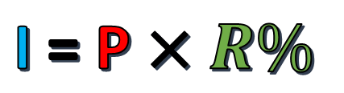
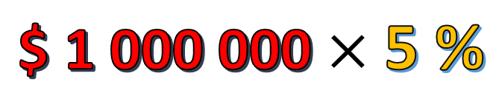

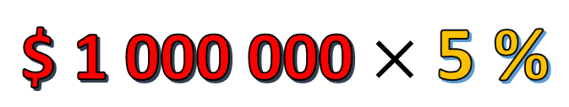


Interest Rate :
5 % per annum (p.a.)
(R%)
Simple Interest :
Principal
(P)
Interest
(I)
I = P $×R\%$
$$×T$$
Amount (A)
A = P $+ \text{I}$
A = P $+ \text{P} ×R\%×T$
A = P $(1+ R\%×T)$
$ 1 000 000
$ 50 000
$$\text{\$ 1 000 000}×\text{5 \%}$$
$ 50 000
$$\text{\$ 1 000 000}×\text{5 \%}$$

Slide 11







Percentage_interest
Simple interest
Principal
Rate
Year
Interest
Example
$1000
3%
5
x
Interest
$$×$$
$$=$$
Principal
Rate
$$×$$
Year
$$=$$
1000
$$×$$
$$×$$
3%
5
$$=$$
$30

Slide 12
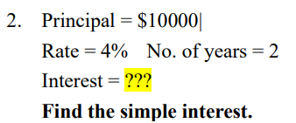
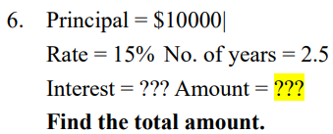





















10000
$$×$$
$$×$$
Simple interest
$$=$$
4%
2
$$=$$
$800
Total amount
$$=$$
Principal
$$+$$
Interest
Total amount
$$=$$
10000
$$+$$
10000
$$×$$
15%
$$×$$
2.5
$$=$$
10000
$$+$$
3750
$$=$$
$13750

Slide 13






Simple interest
Principal
Rate
Year
Interest
Example
x
3%
1
$60
x
$$×$$
$$×$$
$$=$$
$60
3%
1
0.03x
$$=$$
$60
x
$$=$$
2000
$$∴$$
The Principal is $2000.

Slide 14
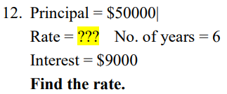
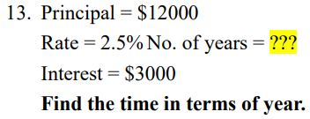













Let the rate be x
Let the number of year be x
50000
$$×$$
$$×$$
$$=$$
9000
x%
6
$$×$$
$$×$$
$$=$$
12000
2.5%
x
3000
x%
$$=$$
0.03
$$=$$
x
10
x
$$=$$
3
$$∴$$
The number of year is 10.
$$∴$$
The rate is 3%.

Slide 15



















Compound interest
Principal
Rate
Year
Interest
Example
$10000
3%
2
x
t
Interest
$$×$$
$$+$$
$$−$$
$$=$$
Principal
(1
r%)
Principal
$$×$$
(1
$$+$$
2
$$−$$
$$=$$
10000
3%)
10000
$$=$$
$609
t
Amount
$$=$$
Principal
$$×$$
(1
$$+$$
r%)
$$×$$
(1
$$+$$
2
$$=$$
10000
3%)
$$=$$
$10609
Interest
Amount
$$−$$
Principal
$$=$$

Slide 16

















t
(a)
Amount
$$=$$
Principal
$$×$$
(1
$$+$$
r%)
$$=$$
$$×$$
(1
$$+$$
3
10000
10%)
$$=$$
$13310
(b)
Compound interest
$$=$$
Amount
$$−$$
Principal
$$=$$
13310
$$−$$
10000
$$=$$
$3310

Slide 17



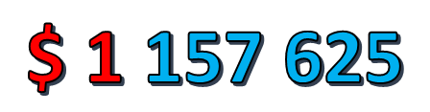
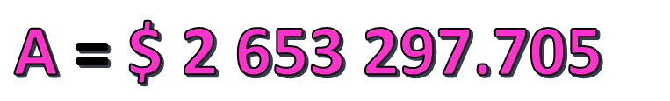
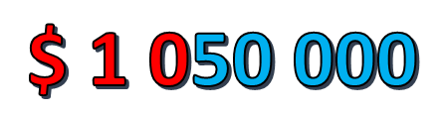
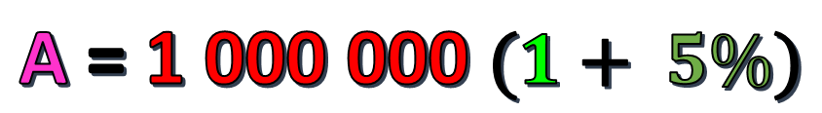

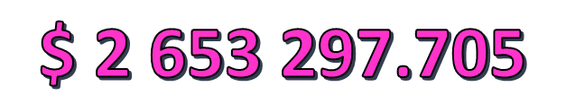
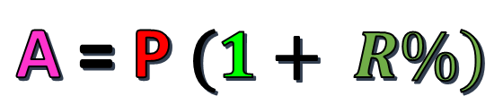
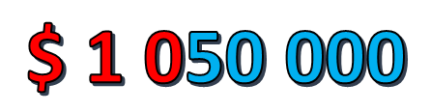

n
A
R
$$\text{\$ 1 000 000}×\text{5 \%}$$
$ 50 000
$$\text{\$ 1 0}\text{50} \text{000}$$
$$×\text{5 \%}$$
1 Yr
$ 52 500
2 Yr
$$\text{\$ 1 }\text{102} \text{500}$$
$$×\text{5 \%}$$
3 Yr
$$\text{\$ 1 }\text{157 625}$$
$$×\text{5 \%}$$
$$\text{\$ 1 0}\text{50} \text{000}$$
$ 1 000 000
20 Yr
$$\text{\$ 2 653 297.705}$$
$ 55 125
Compound Interest :
n
A = P $(1+ R\%)$
20
A = 1 000 000 $(1+ 5\%)$
A = $\text{\$ 2 653 297.705}$

Slide 18



Compound interest
Rate
Year
r%
n
$$×$$
t
A
$$=$$
P
(1
$$+$$
)
n
Amount
Number of times compound in 1 year
Principal

Slide 19
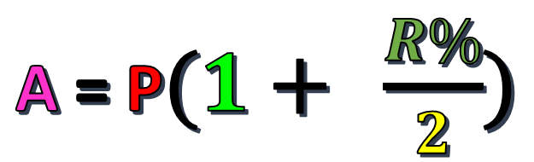

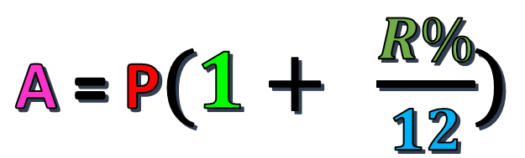
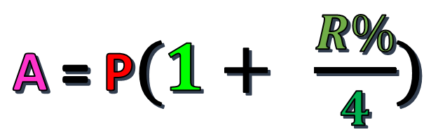
Compound Interest :
n = no. of period
Compounded
Yearly
t
A = P $(1+ R\%)$
t
x 2
Compounded
Half - Yearly
A = P$(1+ \frac{R\%}{2})$
Compounded
Quarterly
A = P$(1+ \frac{R\%}{4})$
t
x 4
Compounded
Monthly
A = P$(1+ \frac{R\%}{12})$
t x 12

Slide 20
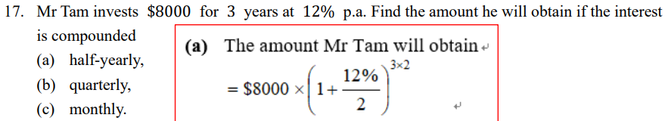





















12%
$$×$$
3
2
$$×$$
$$+$$
(a)
Amount
$$=$$
8000
(1
)
2
$$=$$
$11348
(cor. to nearest integer)
12%
$$×$$
3
4
$$×$$
$$+$$
(b)
Amount
$$=$$
8000
(1
)
4
$$=$$
$11406
(cor. to nearest integer)
12%
$$×$$
3
12
$$×$$
$$+$$
(c)
Amount
$$=$$
8000
(1
)
12
$$=$$
$11446
(cor. to nearest integer)

Slide 21

























Simple interest
r
$$=$$
10%
End of 1st year
r
$$=$$
10%
End of 2nd year
r
$$=$$
10%
End of 3rd year
Present
I
$$=$$
100
I
$$=$$
100
I
$$=$$
100
P
$$=$$
1000
P
$$=$$
1000
P
$$=$$
1000
P
$$=$$
1000
Compound interest
r
$$=$$
10%
End of 1st year
r
$$=$$
10%
End of 2nd year
r
$$=$$
10%
End of 3rd year
Present
I
$$=$$
100
I
$$=$$
110
I
$$=$$
121
P
$$=$$
1000
P
$$=$$
$$+$$
$$+$$
$$+$$
1000
100
P
$$=$$
1100
110
P
$$=$$
1210
121
$$=$$
1100
$$=$$
1210
$$=$$
1331

Slide 22
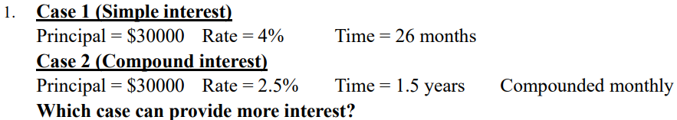

















26
Interest in case 1
$$=$$
30000
$$×$$
$$×$$
4%
16
$$=$$
$2600
2.5%
$$×$$
Interest in case 2
$$=$$
$$×$$
$$+$$
1.5
12
30000
(1
)
$$−$$
30000
12
$$=$$
$1145
(cor. to nearest integer)
$$<$$
$2600
$$∴$$
Simple interest in case 1 provide more interest.

Slide 23
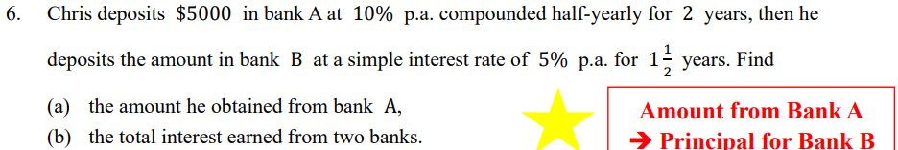





















(a)
Amount Chris obtain from bank A
10%
$$×$$
2
2
$$=$$
$$×$$
$$+$$
5000
(1
)
2
$$=$$
$6078
(cor. to nearest integer)
(b)
Simple interest earned from bank B
$$×$$
$$×$$
$$=$$
6077.53
5%
3
$$=$$
$455.81
Total interest earned in 2 bank
$$=$$
$$−$$
$$+$$
455.81
6077.53
5000
$$=$$
$1533
(cor. to nearest integer)

Slide 24





























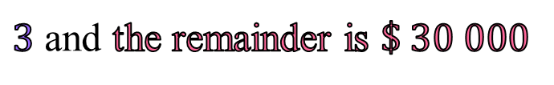






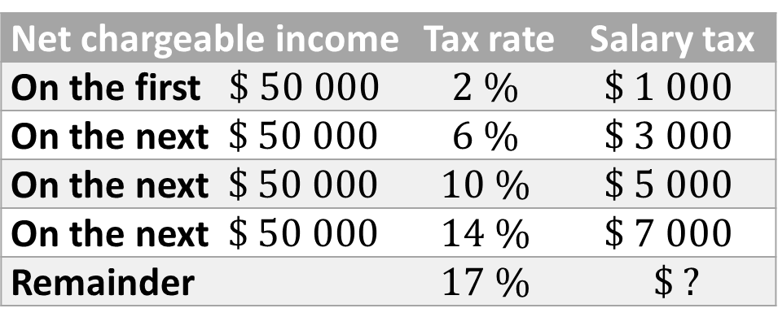
Net chargeable income | Tax rate | Salary tax
On the first $\$ 50 000$ | $$2 \%$$ | $$\$ 1 000$$
On the next $\$ 50 000$ | $$6 \%$$ | $$\$ 3 000$$
On the next $\$ 50 000$ | $$10 \%$$ | $$\$ 5 000$$
On the next $\$ 50 000$ | $$14 \%$$ | $$\$ 7 000$$
Remainder | $$17 \%$$ | $\$ ?$
1
交稅似抽水,
抽到邊桶水?
$$1st$$
$$\$ 50 000$$
$$2nd$$
$$\$ 50 000$$
$$3rd$$
$$\$ 50 000$$
Miss Kwan’s total annual income for the year $2019/20$ is $\$ 300 000$.
If her salaries tax allowance is $\$ 120 000$, how much salaries tax should she pay
$$4th$$
$$\$ 50 000$$
Step 1 Covert total annual income into Net chargeable income
Net chargeable income
$$=$$
total annual income
Tax allowance
$$Remainder$$
$$−$$
$$=$$
$$−$$
$$\text{\$ }\text{12}\text{0 000}$$
$$\text{\$ 180 000}$$
$$\text{\$ }\text{30}\text{0 000}$$
Step 2 How many $\$ 50 000$ can be divided from Net chargeable income?
$$=$$
$3$ and the remainder is $\$ 30 000$
$$\text{\$ 180 000}÷\text{50 000}$$
$$\text{\$ 180 000}$$
$$=$$
$$\text{\$}$$
$$\text{50 000}$$
$$+ \text{50 000}$$
$$+ \text{50 000}$$
$$+ \text{30}\text{ 000}$$
(
)
Step 3 Calculation $Miss Kwan′s salaries tax payable$
$$=\text{50 000}×2\%$$
$$+\text{50 000}×6\%$$
$$+\text{50 000}×10\%$$
$$+ \text{30}\text{ 000}×14\%$$
$$=\$ 13 200$$

Slide 25











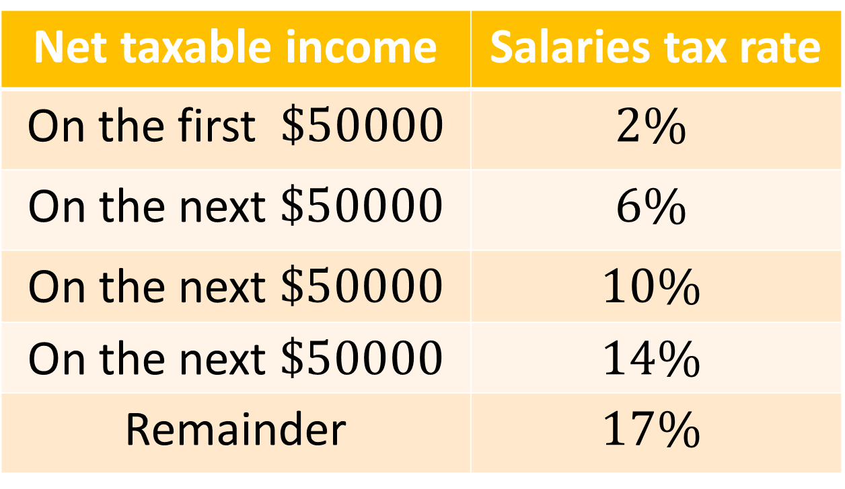

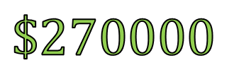

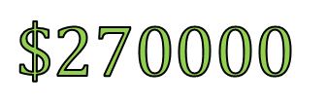


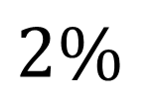

$$Net chargeable income$$
$$\$25000$$
$$Monthly income$$
$$\$25000$$
$$12$$
$$=Annual income−Allowance$$
$$\$270000$$
$$Basic allowence$$
$$\$270000$$
$$Net chargeable income$$
$$\$30000$$
$$=$$
$$×$$
$$−$$
$$=$$
$$\$30000$$
Salaries tax
Net taxable income | Salaries tax rate
On the first $\$50000$ | $$2\%$$
On the next $\$50000$ | $$6\%$$
On the next $\$50000$ | $$10\%$$
On the next $\$50000$ | $$14\%$$
Remainder | $$17\%$$
$$×$$
$$2\%$$
$$=$$
$$\$600$$

Slide 26



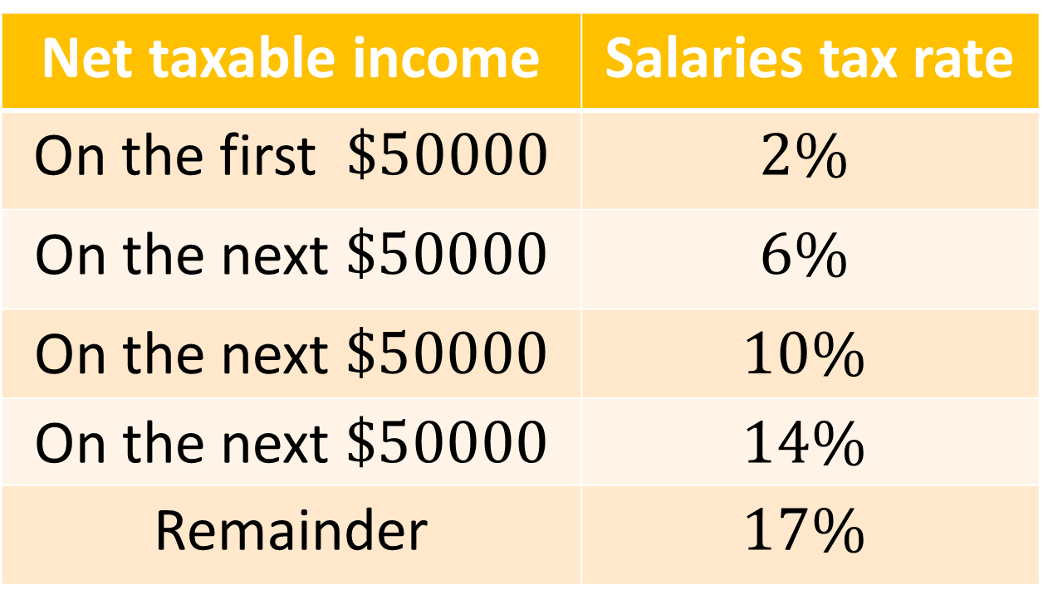















Salaries tax
$$\$50000$$
$$\$50000$$
$$\$50000$$
$$\$50000$$
$$\$230000$$
$$\$30000$$
Net taxable income | Salaries tax rate
On the first $\$50000$ | $$2\%$$
On the next $\$50000$ | $$6\%$$
On the next $\$50000$ | $$10\%$$
On the next $\$50000$ | $$14\%$$
Remainder | $$17\%$$
$$230000−50000×4$$
$$×$$
$$+$$
$$×$$
$$+$$
$$×$$
$$+$$
$$×$$
14%
$$+$$
$$×$$
17%
Salaries tax
$$=$$
50000
2%
50000
6%
50000
10%
50000
30000
$$=$$
$21100

Slide 27
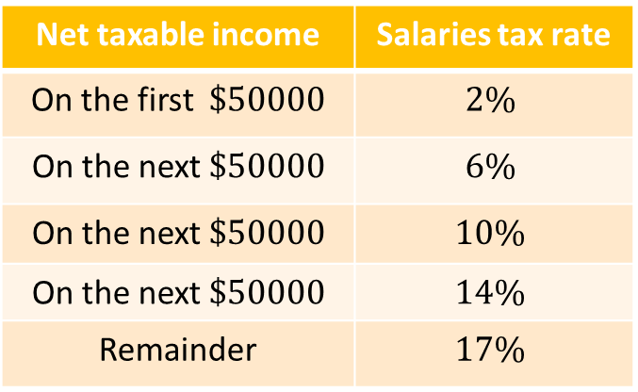



































Let $x be Joyce’s net chargeable income
Net taxable income | Salaries tax rate
On the first $\$50000$ | $$2\%$$
On the next $\$50000$ | $$6\%$$
On the next $\$50000$ | $$10\%$$
On the next $\$50000$ | $$14\%$$
Remainder | $$17\%$$
Peter’s net chargeable income
$$−$$
$$=$$
x
18000
$$<$$
$$−$$
$$<$$
$$−$$
x
118000
18000
$$−$$
82000
18000
100000
100000
18000
Peter’s salaries taxable
$$×$$
$$+$$
x
$$−$$
$$−$$
$$×$$
$$=$$
(
50000
6%
50000
2%
18000
)
$$=$$
0.06x
$$−$$
3080
Joyce’s salaries taxable
$$×$$
$$+$$
$$×$$
$$+$$
x
$$−$$
$$×$$
)
$$×$$
10%
$$=$$
50000
2%
50000
6%
(
50000
2
$$=$$
0.1x
$$−$$
6000
0.1x
$$−$$
$$−$$
$$=$$
6000
(
$$−$$
1760
0.06x
)
3080
0.04x
$$=$$
4680
x
$$=$$
117000
$$∴$$
Joyce’s net chargeable income
$$=$$
$117000

